Slide 1

Software Defects binary Classification using Machine Learning CS 584 – Machine Learning
Anthony Rodriguez ( )
Deshon Langdon (A20503832 )

Slide 2

Problem Statement
Software defects, also known as bugs, are a common occurrence in the software development process.
Early detection of these defects is crucial to prevent such failures and ensure the smooth operation of systems
Lack of detection might be detected until the software is in use.
Very time-consuming and labor-intensive
Difficult to effectively allocate resources for defect management
Scalability and Feasibility issues
Expensive it is to fix after deployment

Slide 3
Proposed Solution & Dataset
Implement various machine learning models for binary classification of software defects. Models include :
Gaussian Naive Bayes, Random Forest Classifier
Bernoulli Naive Bayes, Gradient Boosting Classifier
Decision Tree Classifier, Histogram-based Gradient Boosting Classification Tree
K-Nearest Neighbors Classifier, Light Gradient Boosting Machine
Logistic Regression, Extreme Gradient Boosting
CatBoost Classifier.
Dataset: Binary Classification with a Software Defects Dataset initially containing 101,763 samples. Dataset contained 21 predictors and 1 label column.
Contains 3,662 training (later split into 2,462 training samples, and 1,200 validation samples)
Each row represents a software instance and is labeled under the ‘defects’ column as either ‘False’ (0) or ‘True’ (1), indicating the absence or presence of a software defect.

Slide 4

Proposed Solution & Dataset cont’d
Objective:
Compare the performance of various models to find the most effective model for predicting software defects.
Use the validation set as the test set to evaluate the models’ performances.

Slide 5

Workflow
Data Exploration
Data
Pre-processing
Data
Modelling
Feature selection
Outlier Detection and Standardization
Split dataset into training & validation
Gaussian Naive Bayes
Bernoulli Naive Bayes
Decision Tree Classifier
K-Nearest Neighbours Classifier
InceptionV3
Logistic Regression
Random Forest Classifier
Gradient Boosting Classifier
Histogram-based Gradient Boosting Classification Tree
Checking Missing Values in entries
Checking Duplicates entries
Data Distribution of features and label (defects)
Correlation Analysis

Slide 6
Workflow cont’d
Data
Modelling
Evaluate Results
Data
Modelling
Label validation Data
•Light Gradient Boosting Machine
Extreme Gradient Boosting
CatBoost Classifier
Repeated K-Fold Cross Validation
Evaluation on baseline model
Hyperparameter tuning
Plotting loss and accuracy
Predicting labels for validation data using each optimized model
Model Evaluation on the optimized models

Slide 7
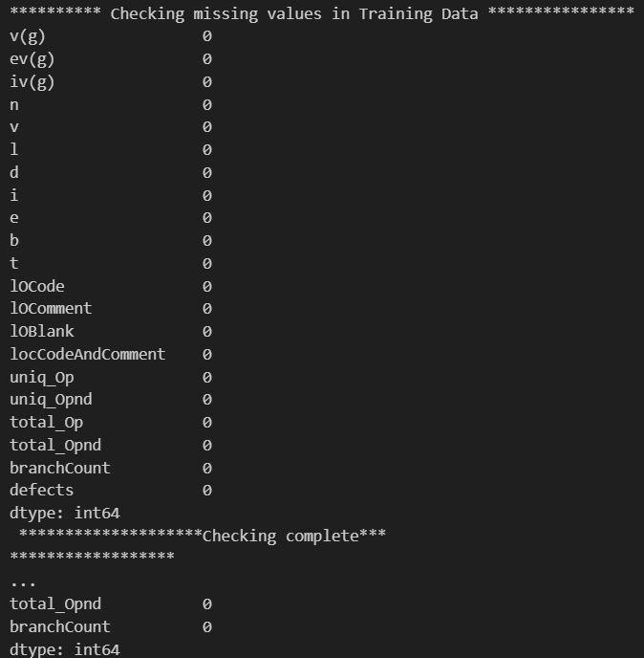
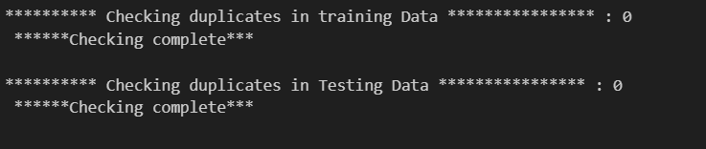
Data Exploration
Both checking missing values duplicates in entries of the dataset give 0 as the results

Slide 8
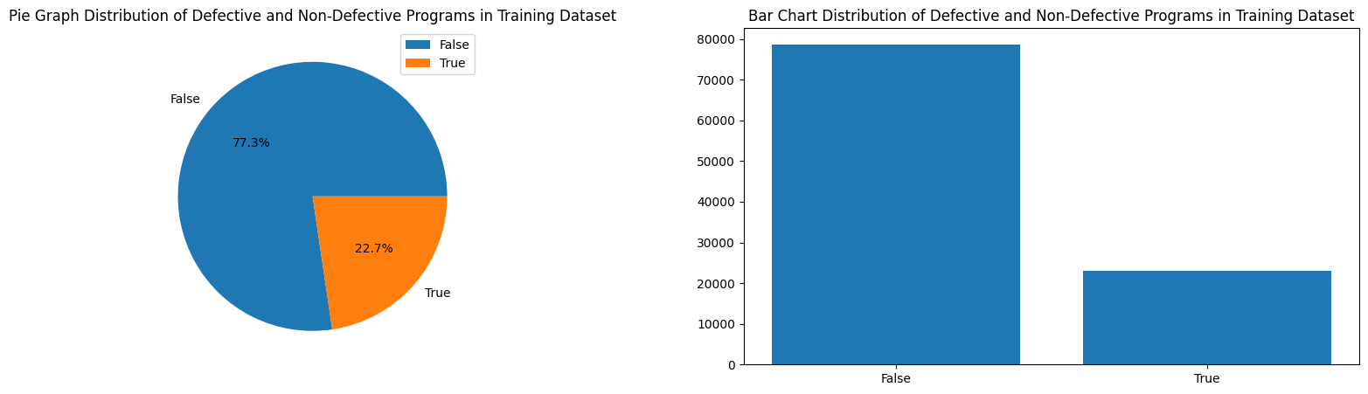
Defects Distribution
Perform visualization of distribution of defective and non-defective programs in the training dataset.
73.33% of data labeled not having defects were remaining 22.7% have defects
Notes:
Perform visualization of distribution of defective and non-defective programs in the training dataset. This helped understand the balance between the two classes in the dataset.

Slide 9
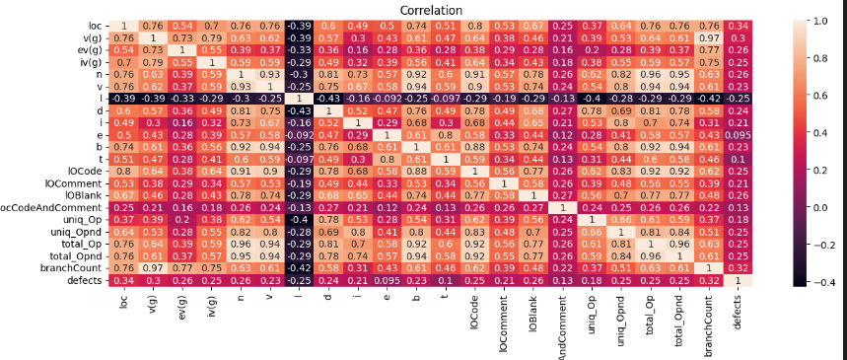
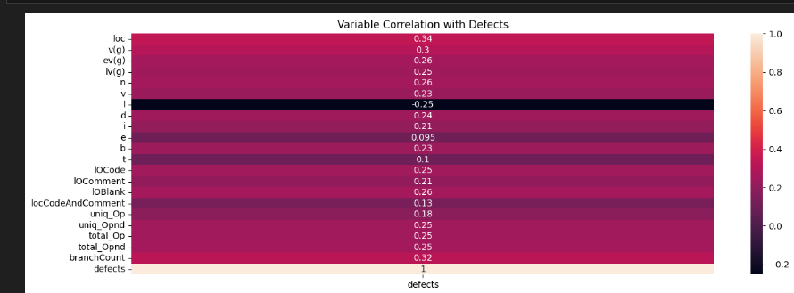
Correlation Analysis

Slide 10
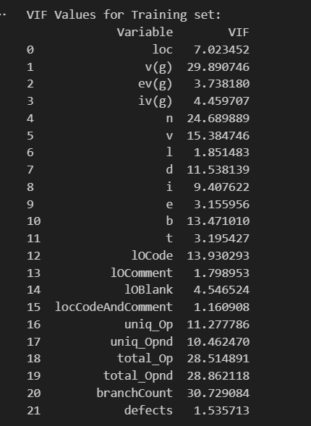
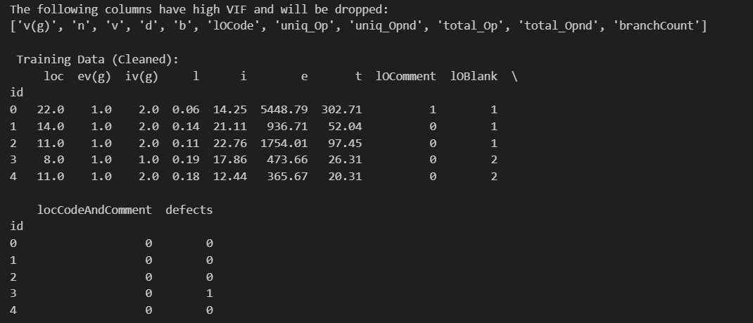
Feature Selection
Perform variance Inflation Factor (VIF) for each feature.
Features with a high VIF are highly correlated with other features and can cause problems in the model, so they are dropped
Notes:
This step involves identifying and removing features that might not be useful for the model. This is done by calculating the Variance Inflation Factor (VIF) for each feature. Features with a high VIF are highly correlated with other features and can cause problems in the model, so they are dropped.

Slide 11
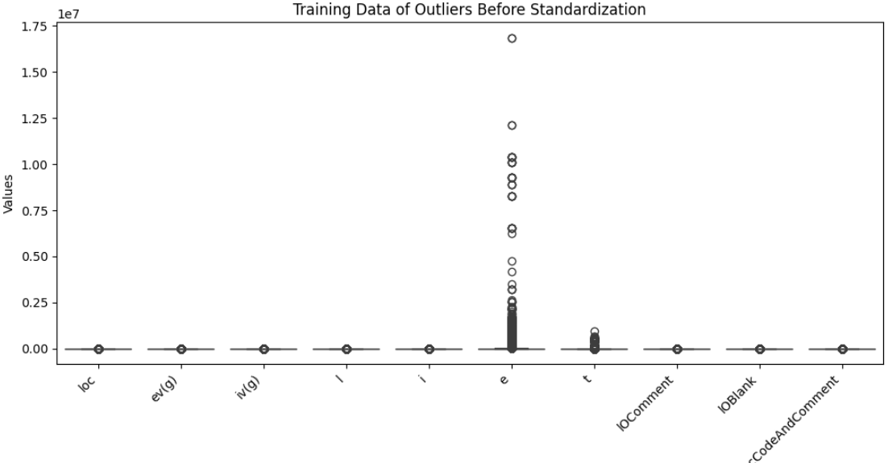
Outlier Detection and Standardization (Before)
Notes:
This step involves identifying and handling outliers in the data. Outliers are extreme values that can skew the model’s performance. The data is also standardized to have a mean of 0 and a standard deviation of 1. This ensures that all features are on the same scale and helps the model to converge faster

Slide 12
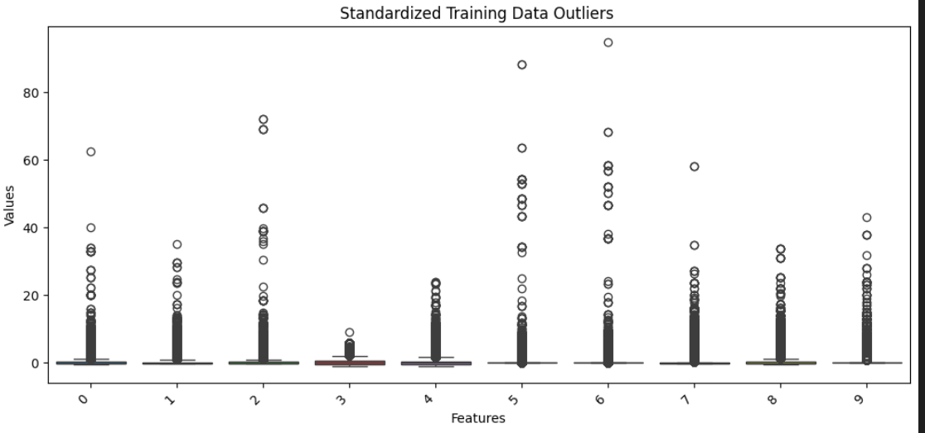
Outlier Detection and Standardization (After)
Notes:
This step involves identifying and handling outliers in the data. Outliers are extreme values that can skew the model’s performance. The data is also standardized to have a mean of 0 and a standard deviation of 1. This ensures that all features are on the same scale and helps the model to converge faster

Slide 15
Planned Future Work

Slide 16


